Slide 1
European Soccer Data –Goal & draws Analysis Soumya Chatterjee

Slide 2
Dataset(s)
Data Set used for Analysis
Soccer Dataset
What you get:
+25,000 matches
+10,000 players
11 European Countries with their lead championship
Seasons 2008 to 2016
Players and Teams' attributes* sourced from EA Sports' FIFA video game series, including the weekly updates
Team line up with squad formation (X, Y coordinates)
Betting odds from up to 10 providers
Detailed match events (goal types, possession, corner, cross, fouls, cards etc...) for +10,000 matches

Slide 3
Motivation
As a passionate soccer enthusiast and as data science enthusiast I was keen to understand and visualize the soccer dataset in terms of Goal & draws recorded in the captured data set. This analysis will help us explore the soccer data set and help us answer the following
Top Leagues Where Most number of Goals Scored
Top Goal Scoring teams
And which League I should avoid as it has most number of matches as draws.
Hopefully this analysis will guide the soccer enthusiast to watch the most exciting European league & matches ,and avoid the scoreless matches.
Lets Gets Started !!!!!!!!!!!!!

Slide 4
Research Question(s)
Find the Top 2 European Leagues in terms of number of Goals scored
Goal comparison between Home Goals vs Away Goals, to find in which league most number of Home Goals are scored ?
Goal comparison between How Goals vs Away Goals ,to find in which league most number of away Goals are scored ?
Find the TOP 10 teams by there Home and away goals.
Most Number Matches with 0-0 score lines by league.

Slide 5
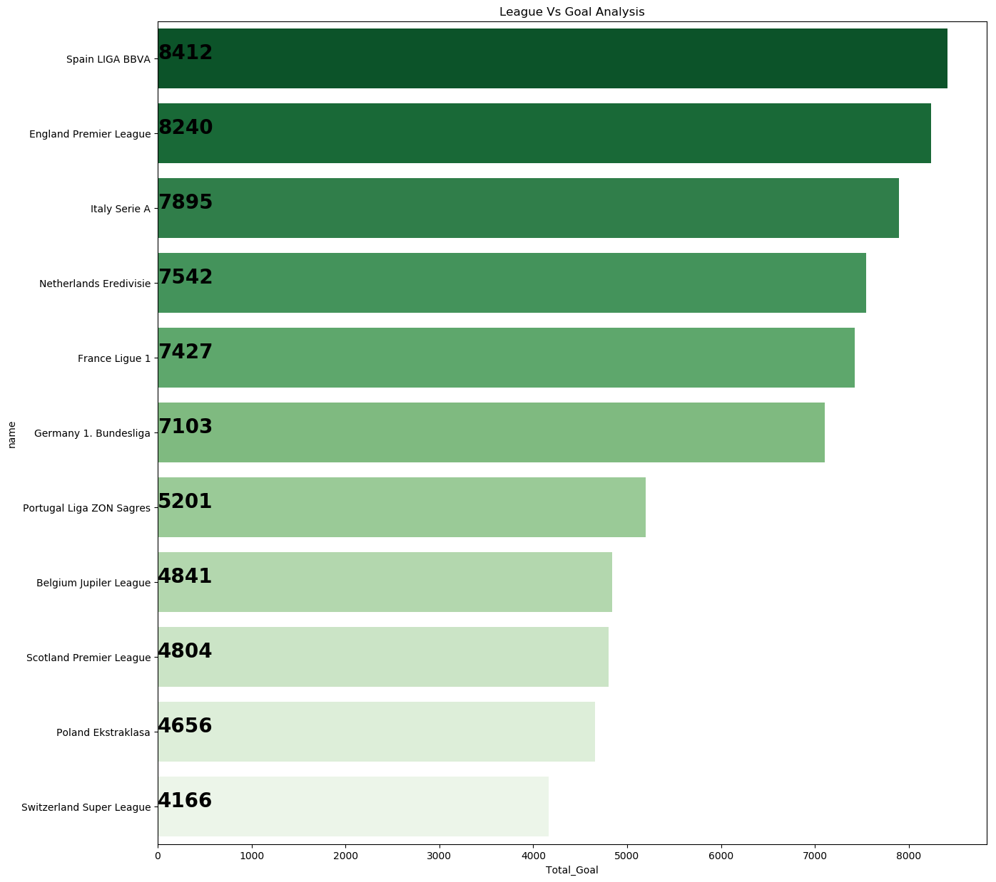
Findings (1)
The Top 2 Teams in the European League are Spanish Liga (8412 goals) and England Premier League (8240 goals)

Slide 6
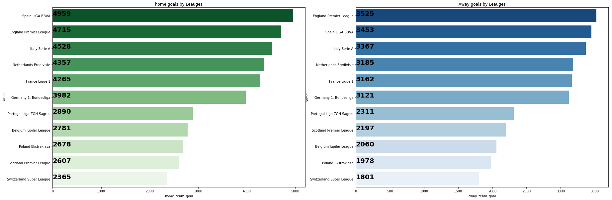
Findings –(2 & 3)
Most Number of Home Goals are scored in Spain LIGA and Most Number of away Goals scored at England Premier League

Slide 7
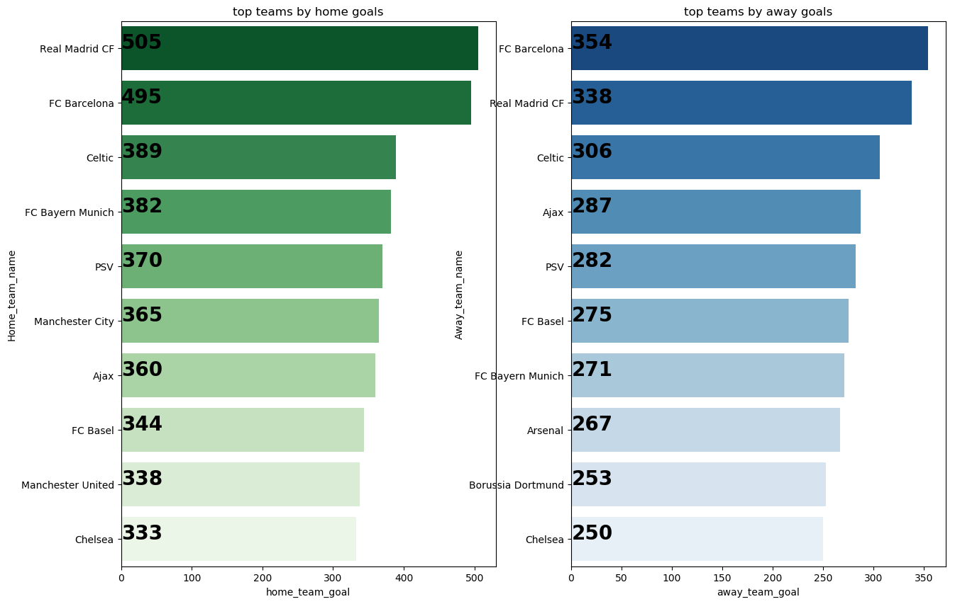
Findings –(4)
TOP 10 teams by there Home and away goals are Shown below – Real Madrid & FC Barcelona are the Most Goal Scoring Teams

Slide 8
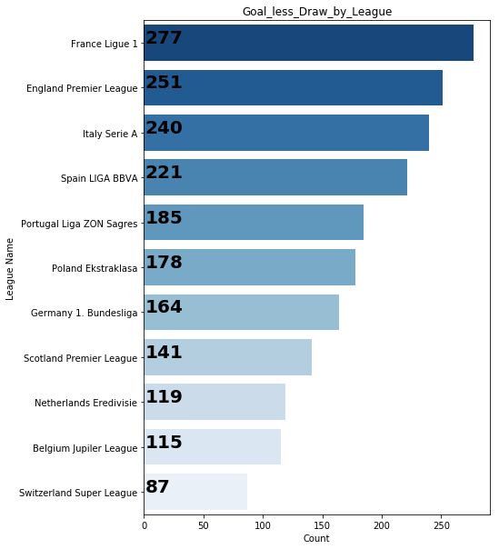
Findings –(5)
Most Number of Scoreless draws were Observed in – France Ligue 1 & Least was observed in Switzerland Super league

Slide 9
Acknowledgement
No Feed back on the work

Slide 10
Reference
Barplot using seaborn library - https://seaborn.pydata.org/generated/seaborn.barplot.html
Barplot
https://preinventedwheel.com/easy-matplotlib-bar-chart/

